Slide 1


LESSON 5
GRAPHS OF TRIGONOMETRIC FUNCTIONS

Slide 2
GRAPHS OF THE TRIGONOMETRIC FUNCTIONS
The trigonometric functions can be graphed on a rectangular coordinate system by plotting the points whose coordinates belong to the function. But the easier way to graph trigonometric functions is by using the properties of each function.
GRAPH OF SINE FUNCTION
The graph of y = sin x
Basic properties:
Domain: All Real numbers
Range: {y|–1 ≤ y ≤ 1}
Period: 2π
Symmetry: With respect to the origin
x – intercepts: At multiples of π
Notes:
Week 3 rbteodoro_06@yahoo.com

Slide 3
























Graph of y = sin x and y = – sin x
x
y | 0 | 0.71 | 1 | 0.71 | 0 | -0.71 | -1 | -0.71 | 0
y
x
o
one cycle

Slide 4
GRAPH OF COSINE FUNCTION
The graph of y = cos x
Basic properties:
Domain: All Real numbers
Range: {y|–1 ≤ y ≤ 1}
Period: 2π
Symmetry: With respect to the y – axis
x – intercepts: At odd multiples of π/2

Slide 5



Graph of y = cos x and y = – cos x
x
y | 1 | 0.71 | 0 | -0.71 | -1 | -0.71 | 0 | 0.71 | 1
y
o
x
one cycle

Slide 6
THE AMPLITUDE AND PERIOD OF SINUSOIDAL GRAPHS
The word sinusoidal means “resembling the sine function”. Any graphs of the form y = sin x or y = cos x are referred to as sinusoidal functions.
Amplitude of sinusoidal functions:
For sinusoidal functions of the form y = a sin bx and
y = a cos bx , the amplitude is the |a|. When |a| < 1, the graph is compressed in the vertical direction, and when |a| > 1, the graph is stretched in the vertical direction.
Period of sinusoidal functions:
For sinusoidal functions of the form y = a sin bx and
y= a cos bx, the period is 2π/|b|. When 0 < b < 1, the graph is stretched in the horizontal direction, and when
b > 1, the graph is compressed in the horizontal direction.

Slide 7
The Graphs of y = a sin (bx + c) + d and y = a cos (bx +c) + d
The graph of y = a sin (bx + c) + d and y = a cos (bx +c) + d, have
Amplitude: |a|
Period: 2π/|b|
Phase Shift: – (c/b)
Vertical Shift: d
The phase shift from y = a sin bx or y = a cos bx is – (c/b) units to the left if – (c/b) > 0 and to the right if – (c/b) < 0.
The vertical shift from y = a sin bx or y = a cos bx is d units up if d > 0 and d units down if d < 0.

Slide 8
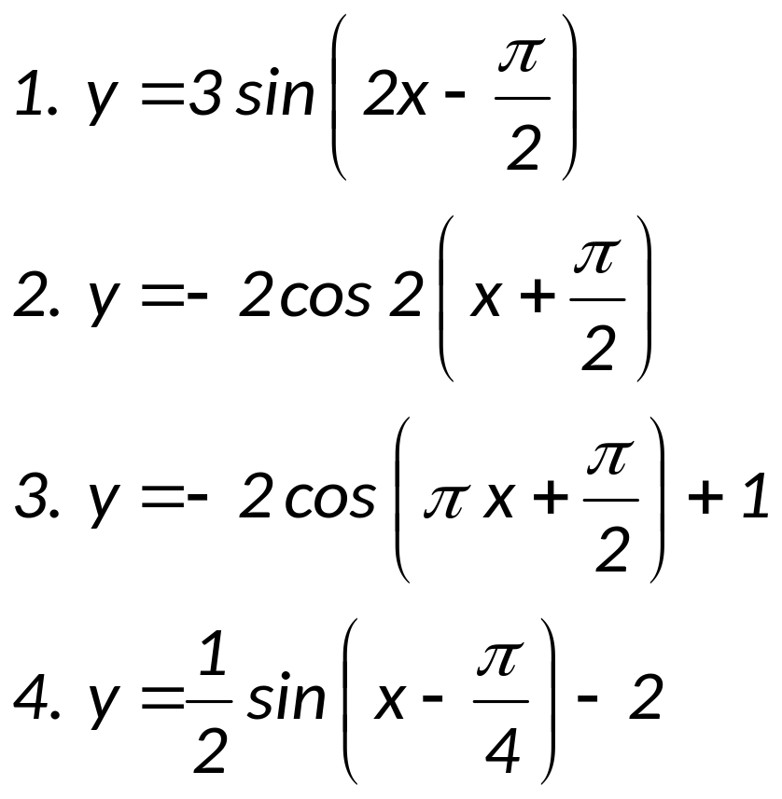
EXAMPLES
I. Determine the amplitude, period, phase shift and vertical shift of each function. Sketch the graph over one period interval.

Slide 9
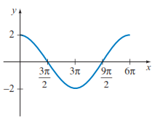
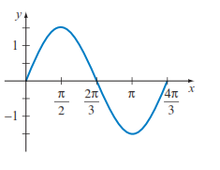
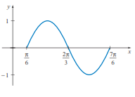
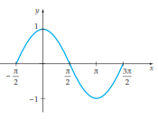
II. Each graph displays one cycle of the graph of trigonometric function, find the equation of each graph.
a)
b)
c)
d)

Slide 10
GRAPH OF TANGENT FUNCTION
The graph of y = tan x
Domain: All real numbers except odd multiples of π/2
Range: All real numbers
Period: π (the graph completes one cycle on the interval
– π/2 < x < π/2)
Symmetry: With respect to the origin
x – intercepts: At multiples of π
Vertical Asymptotes: At odd multiples of π/2
The graph has no defined amplitude, since the function is unbounded.

Slide 11

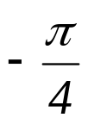



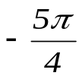

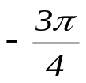
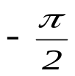
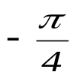
Graph of y = tan x
x
y |  | -1 | 0 | 1
y
o
x
y = tan x
one cycle

Slide 12
GRAPH OF COTANGENT FUNCTION
The graph of y = cot x
Domain: All real numbers except multiples of π
Range: All real numbers
Period: π (the graph completes one cycle on the interval
0 < x < π/b)
Symmetry: With respect to the origin
x – intercepts: At odd multiples of π/2
Vertical Asymptotes: At multiples of π
The graph has no defined amplitude, since the function is unbounded.

Slide 13


Graph of y = cot x
x
y |  | 1 | 0 | -1
y
y = cot x
o
x
one cycle

Slide 14
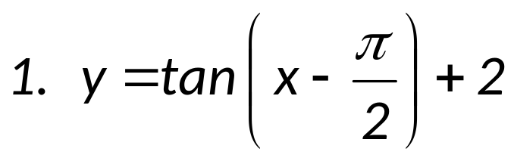
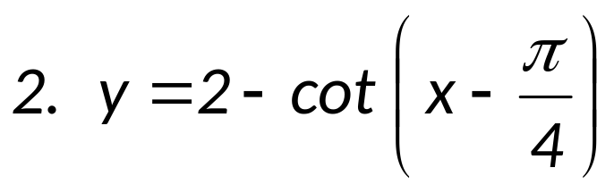
EXAMPLES
Determine the amplitude, period, phase shift and vertical shift of each function. Sketch the graph over one period interval.

Slide 15
GRAPH OF COSECANT FUNCTION
The graph of y = csc x
Domain: All real numbers except multiples of π
Range: { y|y ≥ 1, y ≤ –1}
Period: 2π
Symmetry: With respect to the origin
x – intercepts: none
Vertical Asymptotes: At multiples of π
The graph has no defined amplitude, since the function is unbounded.

Slide 16





Graph of y = csc x
x
y |  | 1.41 | 1 | 1.41 |  | -1.41 | -1 | -1.41
y
x
o
one cycle

Slide 17
GRAPH OF SECANT FUNCTION
The graph of y = sec x
Domain: All real numbers except odd multiples of π/2
Range: { y|y ≥ 1, y ≤ –1}
Period: 2π
Symmetry: With respect to the y – axis
x – intercepts: none
Vertical Asymptotes: At odd multiples of π/2
The graph has no defined amplitude, since the function is unbounded.
Notes:
plane

Slide 18



Graph of y = sec x
x
y | 1 | 1.41 |  | -1.41 | -1 | -1.41 |  | 1.41 | 1
y
x
o
one cycle

Slide 19
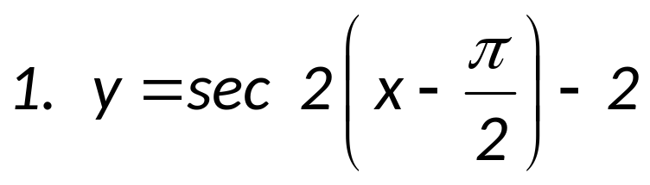
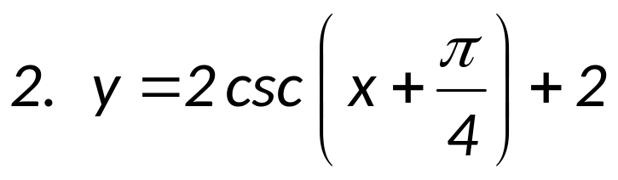
EXAMPLES
I. Determine the amplitude, period, phase shift and vertical shift of each function. Sketch the graph over one period interval.

Slide 20
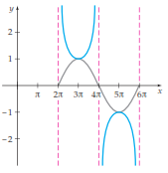
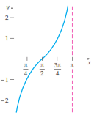
II. Each graph displays one cycle of the graph of a trigonometric function, find the equation of each graph.
a)
b)

